Slide 1
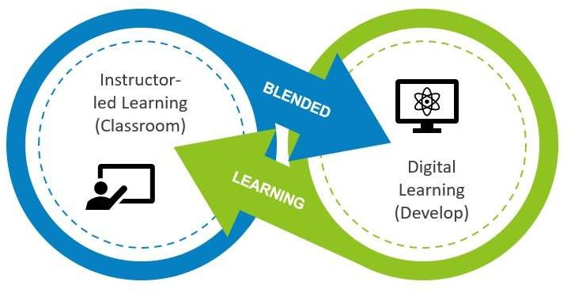
Learning and Development Approaches

Slide 2
Learning and Development Approaches
Job shadowing
coaching
mentoring
Role play

Slide 3
Learning
Align with the overall company strategy.
Impact
Positive impact on job delivery
Return on Investment
Knowledge sharing with team member and company at large.
Valuable knowledge is generated, documented, organized, and shared effectively
Evaluation
Pre training evaluation
Post training evaluation
Assess staff capabilities and identify gaps that requires training.
Enhances staff ability to deliver.

